Slide 1
Interrelation between Federal Student Aid and Adult Literacy Rate for a State
Group Name: Krishna Arjun
Sankalp Bhandari(SSB170006)
Shraddha Bang(SXB180041)

Slide 2
Agenda
Introduction
Target Audience
Description of Data Sources
Data Integration
Demo
Custom Project Justification
Summary

Slide 3
Introduction
Provides the relation between funding provided to the states and their direct effect on the literacy of that sate.
Extracted entities and features are modelled into a semantic ontology and organized in structured format
Created a website which shows different charts and show relations between different entities and features.

Slide 4
Target Audience
This information will be useful for government officials to identify the areas which directly affected by lack of funds and hence, work on improving the condition.
This information may also be used by parents/students to identify developed areas which will ensure a quality education with better facilities

Slide 5
Description of Data Sources
Datasets: Campus Based Program Data for Federal Student Aid
Provides annual recipient, disbursement and federal award information for the Campus-Based Programs by postsecondary school.
https://catalog.data.gov/dataset/campus-based-program-data-for-federal-student-aid
Datasets: 2003 National Assessment of Adult Literacy
This data by NAAL is a cross-sectional assessment that collected information about English literacy among American adults age 16 and older.
https://catalog.data.gov/dataset/2003-national-assessment-of-adult-literacy

Slide 6
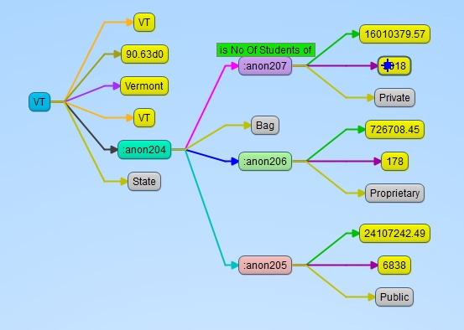
Custom Ontology Description

Slide 7
Data Integration
Selection of the useful features from the downloaded data
Data is stored in csv files
Custom program to create RDF ontology from the features in csv files
Create SPARQL endpoint
Query the SPARQL endpoint from the website
Process response to show in the form of chart

Slide 8
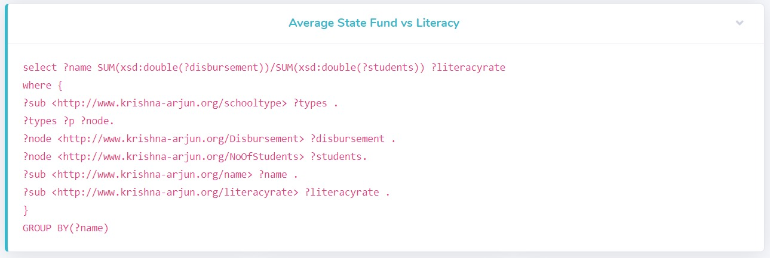
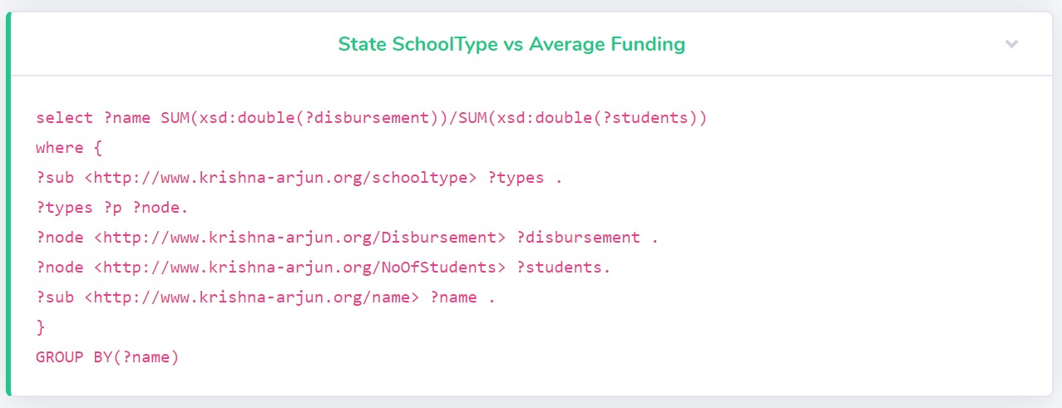
SPARQL Queries

Slide 9
DEMO
https://personal.utdallas.edu/~ssb170006/SWProject/

Slide 10
Custom project Justification
Different source of data – We extracted the data which was relevant to us and did not use the data as it is.
SPARQL Endpoint: We have created our own SPARQL endpoint using the data which we query from our website in Realtime.
Custom Ontology – A custom ontology was defined to model and structure the data and the results displayed were structured using this model.

Slide 11
Summary
As shown in the figures, these relations in the data and successfully displayed on a website for the user to derive meaningful information from
The charts will give government officials a single glance at data to identify problems and they can take related measures to overcome these problems

Slide 12
Thank you!

